Slide 1
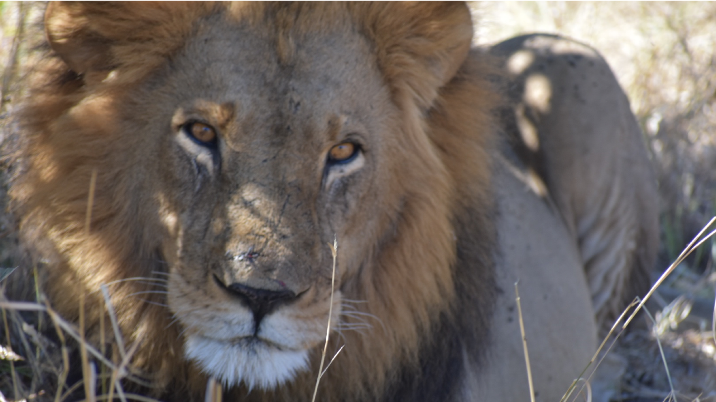
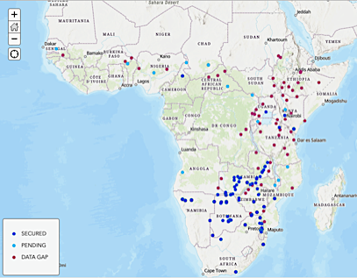
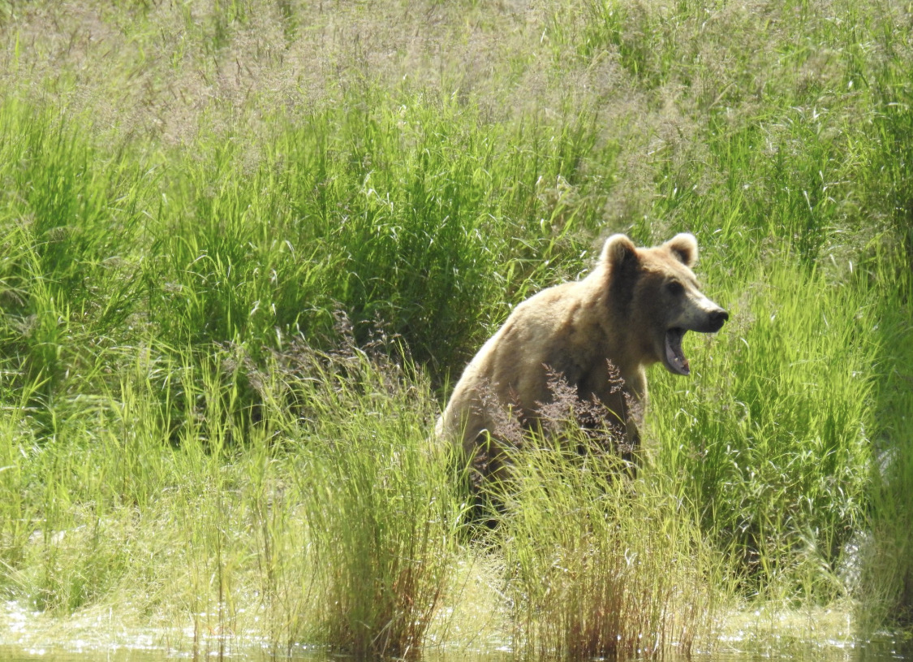

Ellie Armstrong
Washington State University
Postdoctoral Fellow
(Incoming) Assistant Professor
University of California, Riverside
Notes:
Hi everyone, my name is Ellie Armstrong, I am a postdoctoral fellow at Washington State University with Joanna Kelley (who is now at UCSC). I did my PhD at Stanford with Dmitri Petrov and Liz Hadly where I worked on the genomics of large carnivores like the ones pictured here. For my post doc, I have been working on brown bears and some other mesocarnivores. Broadly I am interested in genome evolution and how we can apply genomic data to species conservation, with an emphasis on very large genomic datasets. And I will be starting my own lab next year at UC Riverside in the EEOB department.

Slide 2
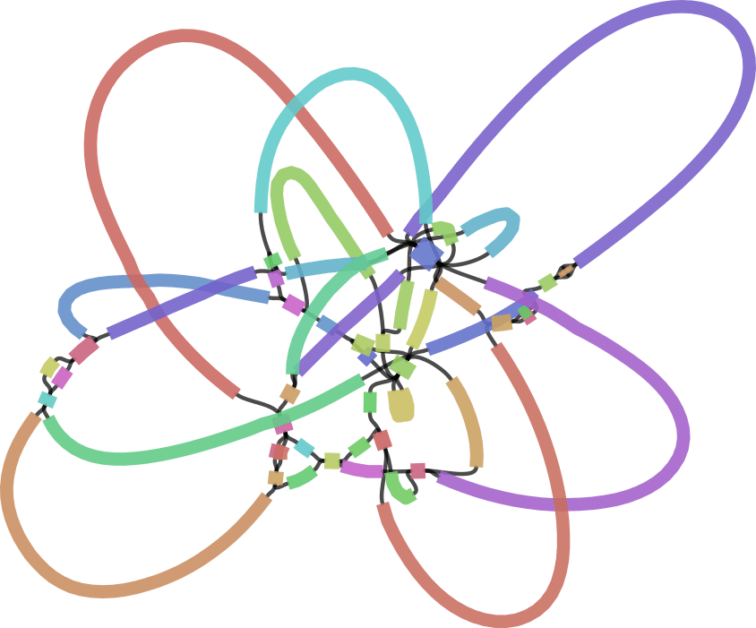

Sequencing Technology & Genome Assembly
Ellie Armstrong
WSU/UC Riverside
@_ellie_cat
Gregg Thomas
Harvard University
@greggwcthomas
Source: Kolmogorov et al. 2019, Nature Biotech
Notes:
So today I am going to be giving you a lecture and then walking you through a hands on session on sequencing technology and Genome Assembly. And I just want to give a huge shoutout to Gregg Thomas at Harvard who is my co-instructor on this and helped me develop much of the materials you will see today and is responsible for the really nice website.

Slide 3
What is a genome assembly?
Notes:
Okay so just to make sure you are awake, let’s start off with a question. What is a genome assembly? Can anyone answer that for me?

Slide 4

A genome assembly is a copy of the information encoded in DNA
…CGGTACAACTGGCA…
Original
Copy
Notes:
So what a genome assembly really is is a copy of the information encoded in DNA. So here is a picture of a pair of chromosomes, and each one of these is comprised of a double helix. And in essence a genome assembly is a copy of that information in the form of a string of letters. More than that, to frame it in an even more computational way, it’s a copy and a change in format, from the chemical patterns encoded by the four nucleotides in the cell, to a string of text characters displayed on a screen.

Slide 5
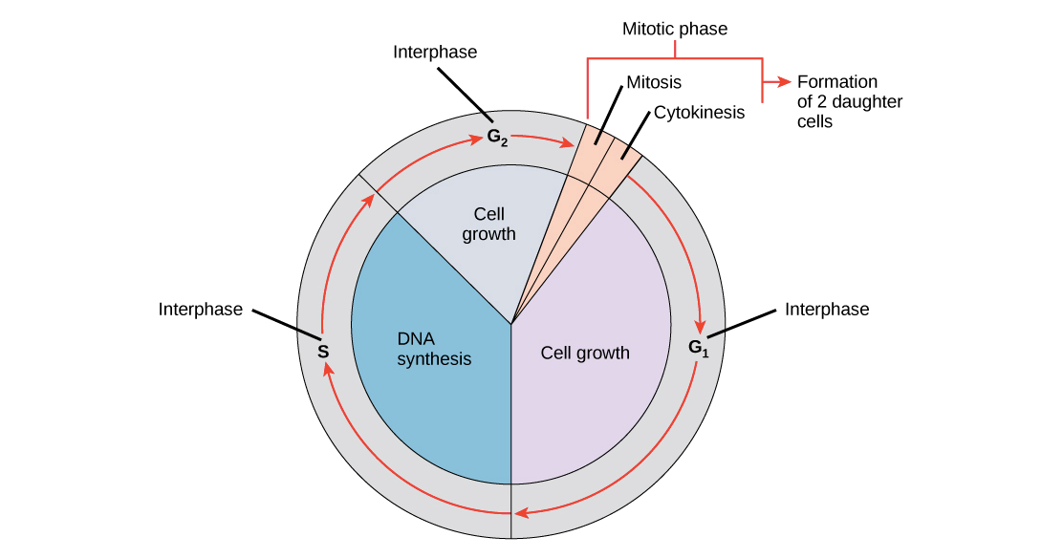
Cells are very good at making copies of their DNA
Original
Copy
Source: https://cnx.org/contents/GFy_h8cu@9.87:1tJ55Ot6@7/The-Cell-Cycle
Notes:
The cells in our body are making copies of their DNA all the time. DNA synthesis is perhaps the most important part of the cell cycle: without it, cells can’t pass their information on when they divide.

Slide 6
Cells are very good at making copies of their DNA
Original
Copy
Humans: ~0.46 errors per cell division
Source: https://cnx.org/contents/GFy_h8cu@9.87:1tJ55Ot6@7/The-Cell-Cycle
Notes:
What’s more, cells are really really good at this. If error rates were too high, the information encoded in the DNA would degrade quickly, and cells wouldn’t be able to function. As it is, we estimate that there are only about 0.46 errors per cell division, or 1 mistake out of 3 billion bases every 2 divisions.

Slide 7
It is more difficult for us to manipulate chemicals at the nano scale than it is for our cells
Difficult!
Original
Copy
Source: https://cnx.org/contents/GFy_h8cu@9.87:1tJ55Ot6@7/The-Cell-Cycle
Notes:
For us, who have only been trying to do this intentionally in the lab for a few decades, we’re still not that good at it because it is so difficult for us to manipulate things easily at such a small scale.

Slide 8
Additional steps are needed for us to read the information in DNA
ATCATGTA
ATCATGTA
ATCATGTA
ATCATGTA
ATCATGTA
…CGGTACAACTGGCA…
ATCATGTA
ATCATGTA
ATCATGTA
ATCATGTA
ATCATGTA
Original
Copy
Notes:
Instead of copying directly from the full chromosome, we have to perform a bunch of additional steps to go from the original DNA to our text encoded copy. Primary among these additional steps is the need to cut the full DNA strand into many many smaller segments, sequence those segments, and then try and put the little pieces back together again.

Slide 9
These steps result in high error rates
ATCATGTA
ATCATGTA
ATCATGTA
ATCATGTA
ATCATGTA
…CGGTACAACTGGCA…
ATCATGTA
ATCATGTA
ATCATGTA
ATCATGTA
ATCATGTA
Original
Copy
Sequencing error rate up to 20%!
Notes:
These additional steps unfortunately introduce lots of opportunities for errors to make their way into the sequence. Some technologies, like the first generation pacbio and nanopore long reads, have a sequencing error rate of up to 20%. These are getting better, but an error rate of even 1% in a genome with 3billion bp means 30 million bases are sequenced incorrectly. This can be devastating for an experiment in which you’re trying to say, identify a variant involved with disease.

Slide 10
A genome assembly is a hypothesis regarding the information encoded in the original DNA
ATCATGTA
ATCATGTA
ATCATGTA
ATCATGTA
ATCATGTA
…CGGTACAACTGGCA…
ATCATGTA
ATCATGTA
ATCATGTA
ATCATGTA
ATCATGTA
Original
Hypothesis
Sequencing error rate up to 20%!
Notes:
What is important to remember is that a genome assembly is a hypothesis about the original information encoded in a cell. And until very recently, our hypotheses for various genomes contained many missing pieces.

Slide 11
A genome assembly is a hypothesis regarding the information encoded in the original DNA
Goal of Genome Assembly:
Accurate chromosome-level representations of the original strand of DNA
ATCATGTA
ATCATGTA
ATCATGTA
ATCATGTA
ATCATGTA
…CGGTACAACTGGCA…
ATCATGTA
ATCATGTA
ATCATGTA
ATCATGTA
ATCATGTA
Original
Hypothesis
Sequencing error rate up to 20%!
Notes:
Ultimately, the goal of a genome assembly, is an accurate and chromosome level representation of that original strand of DNA. Accurate meaning we have the identity of every base pair correct and chromosome-level, meaning we have reconstructed those base pairs into the right order and groups.

Slide 12
1. | A brief history of sequencing technology
2. | de novo Assembly: reads, contigs, and scaffolds
3. | Practical considerations for genome assembly
Notes:
Okay so today this presentation is going to be broken up into various parts. I want to first give an overview of sequencing technology, then I will move into a short introduction to de novo genome assembly and wrap up with some practical considerations.

Slide 13
1. | A brief history of sequencing technology
2. | de novo Assembly: reads, contigs, and scaffolds
3. | Practical considerations for genome assembly
Notes:
So let’s start out with a brief history on DNA sequencing technology. And what I really want you to focus on here is the sources of error across the various technologies and how the trade off between error rate and the length of sequencing reads might affect downstream analyses.

Slide 14
Synthesizing and reading long fragments of DNA is hard
…TAGAAAACGCGATCTTACGGCGGTACATTAGGGTTCTACCCCAACCTCTTCGAGCAGTTAATGCGCGGGACGTCCGGAGTTCTCTCGCAATCTGAACATT…
Notes:
So we already talked a little bit about why sequencing and reading long fragments of DNA is hard

Slide 15

Synthesizing and reading long fragments of DNA is hard
The Human Genome
…TAGAAAACGCGATCTTACGGCGGTACATTAGGGTTCTACCCCAACCTCTTCGAGCAGTTAATGCGCGGGACGTCCGGAGTTCTCTCGCAATCTGAACATT…
Notes:
If we think of the genome like a book, the easiest thing to do would just be to open it and order it word by word and line by line

Slide 16
Synthesizing and reading long fragments of DNA is hard
x
The Human Genome
…TAGAAAACGCGATCTTACGGCGGTACATTAGGGTTCTACCCCAACCTCTTCGAGCAGTTAATGCGCGGGACGTCCGGAGTTCTCTCGCAATCTGAACATT…
GGACGTCCGGA
CGGTACAT
CGGTAACTCAG
TAGAAAACGC
CTACCC
Notes:
Unfortunately we can’t do that, so instead what we have is like a book ended up in a wood chipper and there are all these word and page fragments floating around and we have to put them back together.

Slide 17
Synthesizing and reading long fragments of DNA is hard
x
The Human Genome
…TAGAAAACGCGATCTTACGGCGGTACATTAGGGTTCTACCCCAACCTCTTCGAGCAGTTAATGCGCGGGACGTCCGGAGTTCTCTCGCAATCTGAACATT…
GGACGTCCGGA
CGGTACAT
Sequence reads
CGGTAACTCAG
TAGAAAACGC
CTACCC
Notes:
And when we are thinking about sequencing, these fragments are called sequence reads.

Slide 18
Reads are short fragments of sequenced DNA
Read length depends on sequencing platform
Platform | Typical read length | # of reads to cover human genome once
Sanger | 800 bp | 3.75 million
Illumina paired-end | 150 bp | 20 million
Long read technologies | >10,000 bp | 300,000
Notes:
And reads come in different flavors depending on the type of technology that you are using. So for Sanger sequencing, which I will I will briefly discuss today it has a read length of about 800. It is very accurate, but you would need to do sanger sequencing 3.75 million times to cover the human genome once, assuming that read length. For something like Illumina, which has a much shorter read length, you would need 20 million reads to cover the genome. For some long read technologies like pacbio and illumina, you fewer reads, on the order of 300,000.

Slide 19
Reads are short fragments of sequenced DNA
Read length depends on sequencing platform
Platform | Typical read length | # of reads to cover human genome once
Sanger | 800 bp | 3.75 million
Illumina paired-end | 150 bp | 20 million
Long read technologies | 10,000 bp | 300,000
Instead of a single linear representation of DNA, we end up with many short, overlapping pieces of the original DNA

Slide 20
How do we sequence reads?
1970
1980
1990
2000
2010
2020
Notes:
So how do we actually sequence reads? And I have this little timeline at the bottom so we can sort of keep track of where we are compared to the inception of DNA sequencing technology which begins with Sanger sequencing in the 1970s.

Slide 21
Sanger sequencing (Chain termination method)
DNA
CTGACTTCGACAA
Normal nucleotides (dNTPs)
A
T
C
G
Modified nucleotides (ddNTPs)
A*
T*
C*
G*
DNA polymerase
Sanger
1970
1980
1990
2000
2010
2020
Notes:
So Sanger sequencing is also known as the chain termination method for reasons that should become obvious. So just a show of hands how many people are really familiar with how sanger works in here before I dive in so that I can move through this quickly. Okay so Sanger as you know we have a mix of dNTPs which are our normal nucleotides and ddNTPs wiich are fluorescently tagged. We also have our template DNA and DNA polymerase which is an enzyme that builds new DNA strands,

Slide 22

Sanger sequencing (Chain termination method)
DNA
CTGACTTCGACAA
Normal nucleotides (dNTPs)
A
T
C
G
Modified nucleotides (ddNTPs)
A*
T*
C*
G*
DNA polymerase
Sanger
1970
1980
1990
2000
2010
2020
Notes:
We throw this all in a tube together and add heat to activate our enzyme.

Slide 23
Sanger sequencing (Chain termination method)
GACTGAAGCTGTT*
DNA
CTGACTTCGACAA
GACTGAAGCTGT*
GACTGAAGCTG*
Normal nucleotides (dNTPs)
A
T
GACTGAAGCT*
C
G
GACTGAAGC*
GACTGAAG*
Modified nucleotides (ddNTPs)
A*
T*
GACTGAA*
C*
G*
GACTGA*
GACTG*
DNA polymerase
GACT*
GAC*
GA*
G*
Sanger
1970
1980
1990
2000
2010
2020
Notes:
So what ends up happening is that sometimes the polymerase incorporates a fluorescent ddNTP and sometimes it incorporates a regular one. And so we end up with strands of DNA that look something like this, where when the fluorescent ddNTP is incorporated, the chain terminates.

Slide 24
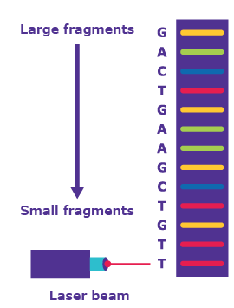
Sanger sequencing (Chain termination method)
GACTGAAGCTGTT*
GACTGAAGCTGT*
GACTGAAGCTG*
GACTGAAGCT*
GACTGAAGC*
GACTGAAG*
GACTGAA*
GACTGA*
GACTG*
GACT*
GAC*
GA*
G*
Source: https://www.sigmaaldrich.com/technical-documents/articles/biology/sanger-sequencing.html
Sanger
1970
1980
1990
2000
2010
2020
Notes:
You can run these strands out on a gel using electrophoresis which will pull our smaller fragments down based on the charge of DNA. And so the fragments will be ordered from smallest to longest on a gel. And for each fragment length there is one of these flurorescent bases incorporated and when we shine a laser through it.

Slide 25
Sanger sequencing (Chain termination method)
GACTGAAGCTGTT*
GACTGAAGCTGT*
GACTGAAGCTG*
GACTGAAGCT*
GACTGAAGC*
GACTGAAG*
GACTGAA*
GACTGA*
GACTG*
GACT*
GAC*
GA*
G*
Source: https://www.sigmaaldrich.com/technical-documents/articles/biology/sanger-sequencing.html
Sanger
1970
1980
1990
2000
2010
2020

Slide 26
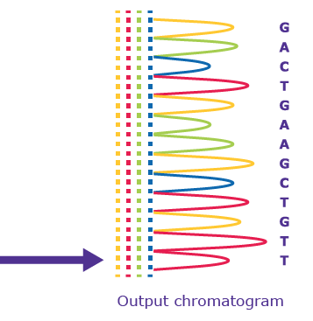
Sanger sequencing (Chain termination method)
GACTGAAGCTGTT*
GACTGAAGCTGT*
GACTGAAGCTG*
GACTGAAGCT*
GACTGAAGC*
GACTGAAG*
GACTGAA*
GACTGA*
GACTG*
GACT*
GAC*
GA*
G*
Sanger
Source: https://www.sigmaaldrich.com/technical-documents/articles/biology/sanger-sequencing.html
1970
1980
1990
2000
2010
2020
Notes:
We can then convert this into a signal which corresponds to the various nucleotides and determine the sequence of the DNA we are interested in.

Slide 27
Sanger sequencing (Chain termination method)
GACTGAAGCTGTT*
GACTGAAGCTGT*
GACTGAAGCTG*
Sequencing by synthesis
Methods that use DNA polymerase to create a complementary DNA strand based on a template and measure some signal as bases are added
GACTGAAGCT*
GACTGAAGC*
GACTGAAG*
GACTGAA*
GACTGA*
GACTG*
GACT*
GAC*
GA*
G*
Sanger
Source: https://www.sigmaaldrich.com/technical-documents/articles/biology/sanger-sequencing.html
1970
1980
1990
2000
2010
2020
Notes:
So this kind of sequence is broadly termed sequencing by synthesis, which you will often hear. And all this refers to is the fact that we are using polymerase to create a complementary strand based on template and measuring the signal of the bases whether that is with light or other signal.

Slide 28
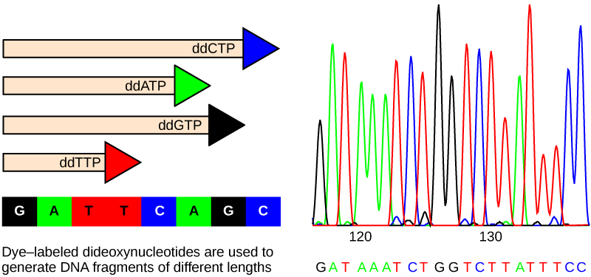
Sanger sequencing (Chain termination method)
Read length ~800bp
Very low error rate (as low as 0.001%)
Very slow (low throughput)
Sanger
1970
1980
1990
2000
2010
2020
Notes:
So sanger sequencing is very accurate, the reads are fairly long, but the major downside is that it is very low throughput.

Slide 29
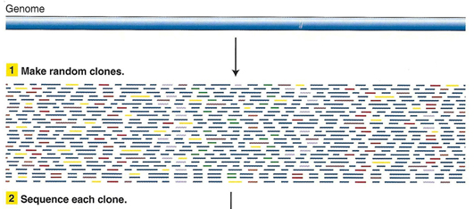
The “shotgun” method improves throughput of Sanger sequencing
Source: http://www.discoveryandinnovation.com/BIOL202/notes/lecture24.html
Sanger
1970
1980
1990
2000
2010
2020

Slide 30
The “shotgun” method improves throughput of Sanger sequencing
This introduces a problem: how do we put the small overlapping sequences back together – Genome Assembly
Source: http://www.discoveryandinnovation.com/BIOL202/notes/lecture24.html
Sanger
1970
1980
1990
2000
2010
2020

Slide 31
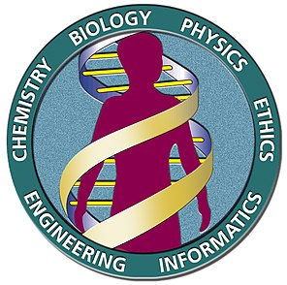
Sanger sequencing was the driver behind the first generation of sequenced genomes
The human genome (completed in 2003) used whole-genome “shotgun” Sanger sequencing and sequencing of bacterial artificial chromosomes (BACs).
D. melanogaster
Source: https://en.wikipedia.org/wiki/Human_Genome_Project
Yeast
C. elegans
First bacterial genomes sequenced
Human Genome Sequenced
Sanger
1970
1980
1990
2000
2010
2020

Slide 32
Second generation sequencing increases throughput
Detect signal as nucleotides are added to template DNA
Affix template DNA to physical media (beads, flowcells) with adapters to facilitate localized amplification
  SOLiD, 454 Pyrosequencing, IonTorrent
Human Genome Sequenced
Sanger
1970
1980
1990
2000
2010
2020

Slide 33
Illumina sequencing
Affix DNA to flowcells and synthesize with DNA polymerase
Source: Heather and Chain 2016, Genomics
Solexa (now Illumina)
454
Human Genome Sequenced
Sanger
1970
1980
1990
2000
2010
2020

Slide 34
Illumina sequencing
Affix DNA to flowcells and synthesize with DNA polymerase
Detect sequence by light that is emitted as DNA is synthesized (no need to terminate the chain)
Solexa (now Illumina)
454
Source: Heather and Chain 2016, Genomics
Human Genome Sequenced
Sanger
1970
1980
1990
2000
2010
2020

Slide 35
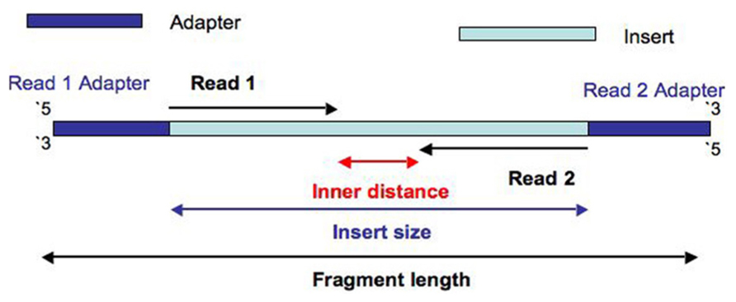
Illumina paired-end sequencing
Affix DNA to flowcells and synthesize with DNA polymerase
Detect sequence by light that is emitted as DNA is synthesized (no need to terminate the chain)
Source: https://thesequencingcenter.com/knowledge-base/what-are-paired-end-reads/
Solexa (now Illumina)
454
Human Genome Sequenced
Sanger
1970
1980
1990
2000
2010
2020

Slide 36
Third generation sequencing promises longer, higher quality assemblies
Solexa (now Illumina)
Ion Torrent
454
PacBio SMRT
Human Genome Sequenced
SOLiD
Sanger
1970
1980
1990
2000
2010
2020

Slide 37
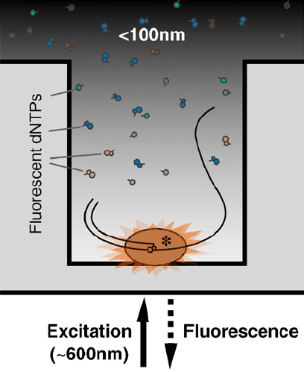
PacBio single molecule real-time sequencing (SMRT)
Affix the polymerase to the bottom of a well, the diameter of which is smaller than the wavelength of light emitted by the fluorescent dNTPs
PacBio has two modes (CLR and HiFi) which you will hear about later!
Solexa (now Illumina)
454
Ion Torrent
Human Genome Sequenced
SOLiD
PacBio SMRT
Sanger
1970
1980
1990
2000
2010
2020

Slide 38
Oxford Nanopore
No amplification or modification of DNA required (directly sequencing molecule)
  PCR is not necessary, but some protocols use it
Electric current is monitored as DNA is fed through a pore in a membrane
Solexa (now Illumina)
Oxford Nanopore
454
Source: Heather and Chain 2016, Genomics
Human Genome Sequenced
PacBio SMRT
Sanger
PacBio HiFi
1970
1980
1990
2000
2010
2020
Notes:
Pore attaches to 5 prime end. Duplex sequencing relies on the fact that the leading and lagging strand are sequenced one after the other due to likelihood of the complement strand (initial strand sequenced is called template strand).

Slide 39
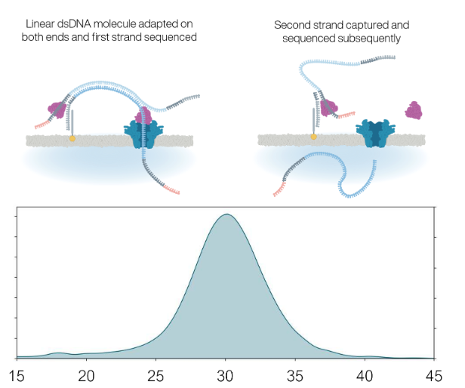
Oxford Nanopore
Nanopore struggles with low complexity regions
  Speed not constant, so homopolymer length can be inaccurate
  Minor variation in signal changes
Duplex sequencing has improved accuracy by order of magnitude
Different base calling accuracy models will impact output
Solexa (now Illumina)
Oxford Nanopore
454
Human Genome Sequenced
PacBio SMRT
Sanger
PacBio HiFi
1970
1980
1990
2000
2010
2020
Notes:
Pore attaches to 5 prime end. Duplex sequencing relies on the fact that the leading and lagging strand are sequenced one after the other due to likelihood of the complement strand (initial strand sequenced is called template strand).

Slide 40
Sequencing technology overview
Technology | Read length | Error rate | Sources of error | Active?
Sanger | ~800bp | 0.001% |  | Y
454 | 700bp | 1% | No temporary chain termination makes homopolymers difficult to resolve Incomplete cleaning of wells between cycles can generate noise | N
Illumina | 150bp | 1-2.5% | Errors increase towards end of reads due to dephasing | Y
SOLiD | 75bp | 0.06% |  | N
Ion Torrent | 200bp | 1.5-4.5% | Signal degradation occurs during sequencing of homopolymers | Y
PacBio SMRT | 10-300kbp | 13-15% | random | Y
PacBio HiFi | 10-300kbp | <1% | random | Y
Oxford Nanopore R9.4.1 |  | 1-5% | homopolymers | Y
Oxford Nanopore R10.4.1 | 10-20kbp, up to 100kbp | <=1% | homopolymers, but less in new flow cells | Y

Slide 41

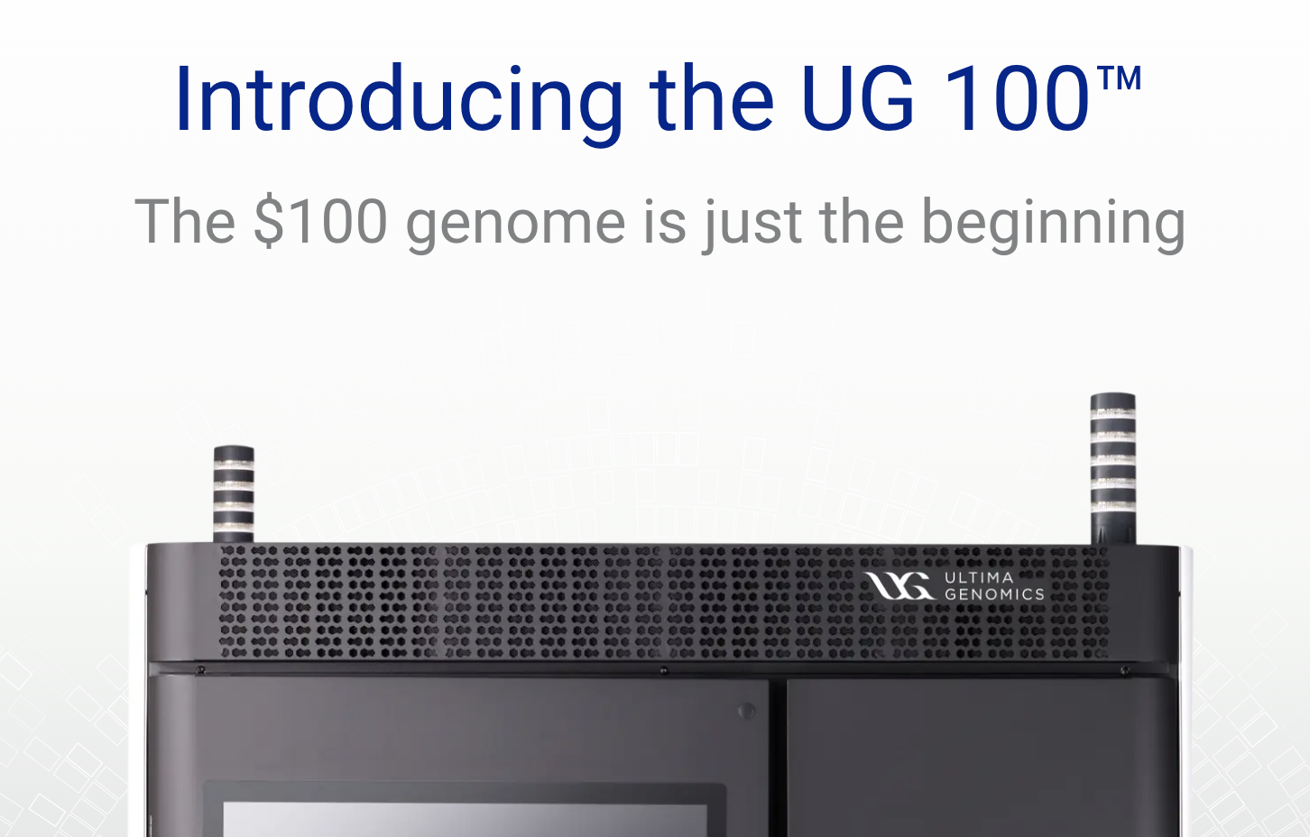

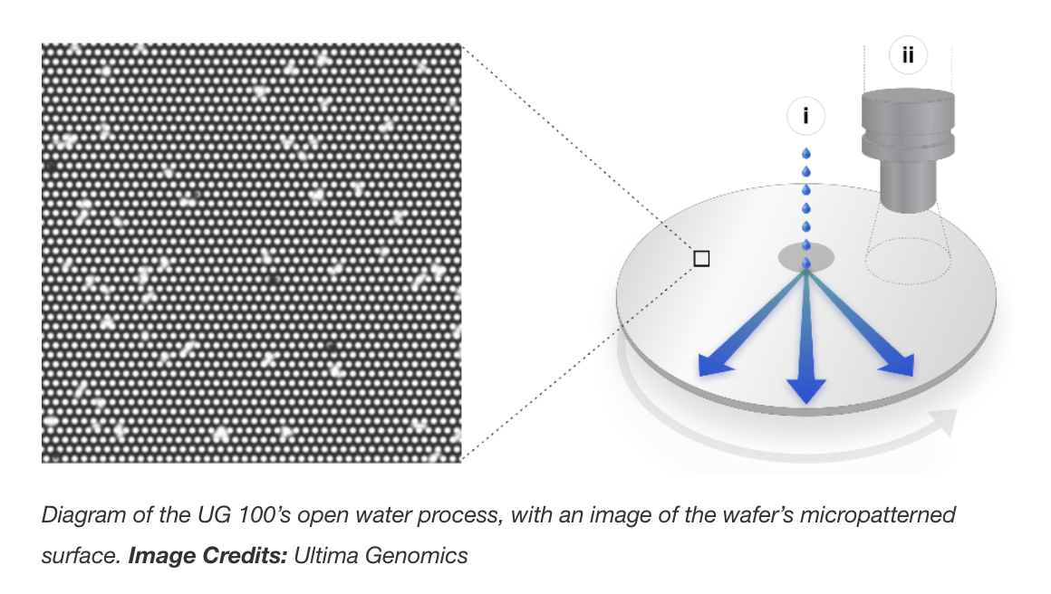

The ‘New Kids’ on the Block
Notes:
Modify this

Slide 42
1. | A brief history of sequencing technology
2. | de novo Assembly: reads, contigs, and scaffolds
3. | Practical considerations for genome assembly

Slide 43
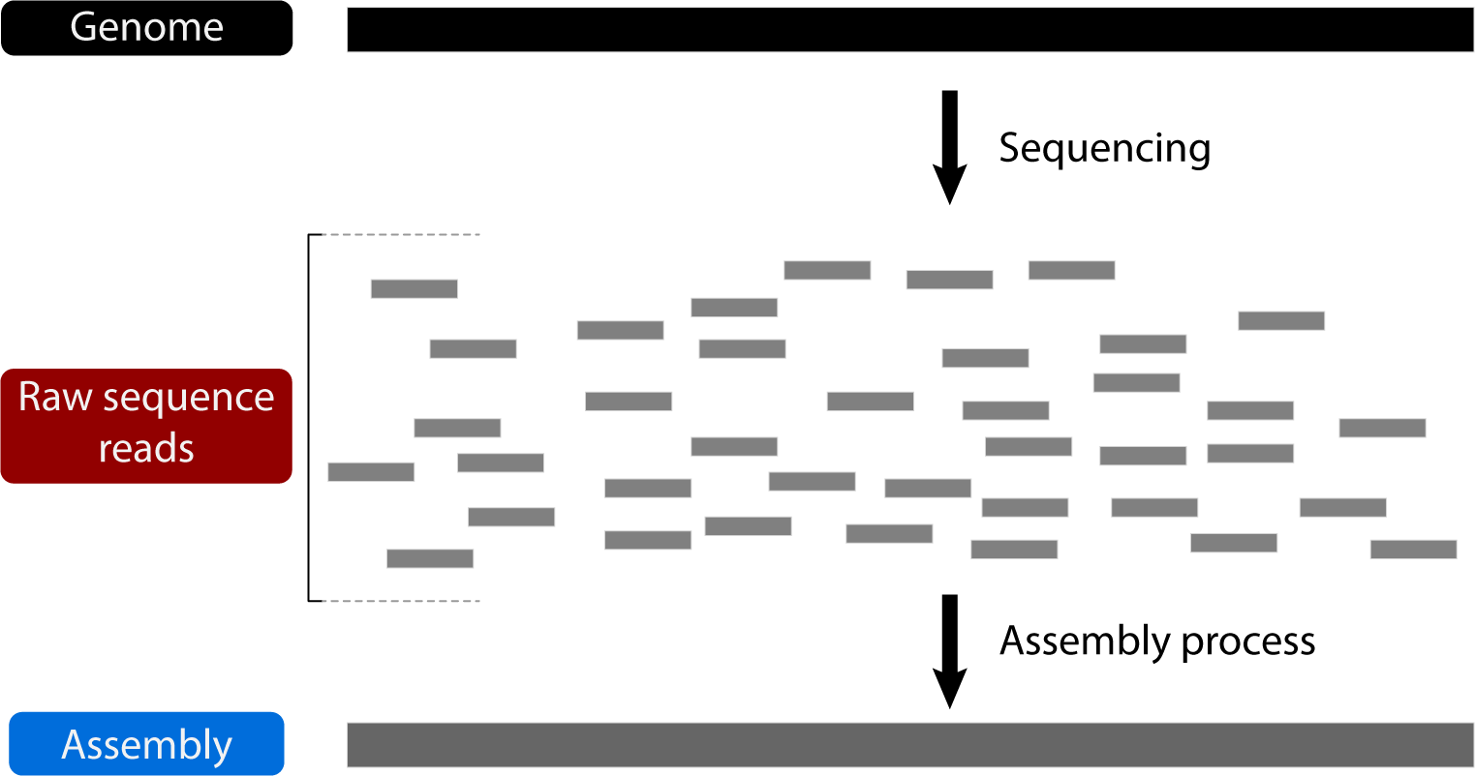
How do we reconstruct the genome from reads?

Slide 44

How do we reconstruct the genome from reads?

Slide 45
How do we reconstruct the genome from reads?
x
Overlapping pieces

Slide 46
How do we reconstruct the genome from reads?
x
Overlapping pieces
We don’t know the original sequence

Slide 47
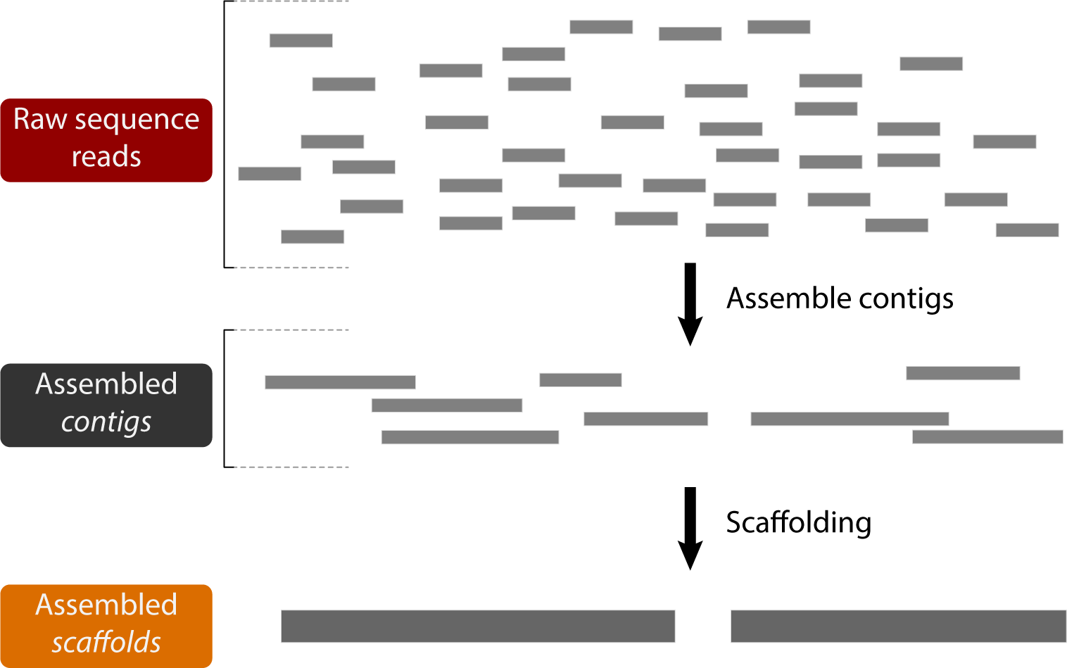
How do we reconstruct the genome from reads?

Slide 48
How do we reconstruct the genome from reads?
A contig (short for contiguous) is a sequence that has been generated by assembling reads

Slide 49
How do we reconstruct the genome from reads?
A contig (short for contiguous) is a sequence that has been generated by assembling reads
A scaffold is made up of adjacent contigs separated by gaps (stretches of Ns)

Slide 50
How do we assemble contigs from reads?
?

Slide 51
Two main classes of contig assembly algorithms
Source: http://www.cs.jhu.edu/~langmea/resources/lecture_notes/20_assembly_scaffolding_v2.pdf

Slide 52
Two main classes of contig assembly algorithms
Graph based algorithms
Source: http://www.cs.jhu.edu/~langmea/resources/lecture_notes/20_assembly_scaffolding_v2.pdf
Notes:
These are both graph-based algorithms, meaning we treat the reads as nodes in a graph, and their overlaps as edges in the graph.

Slide 53
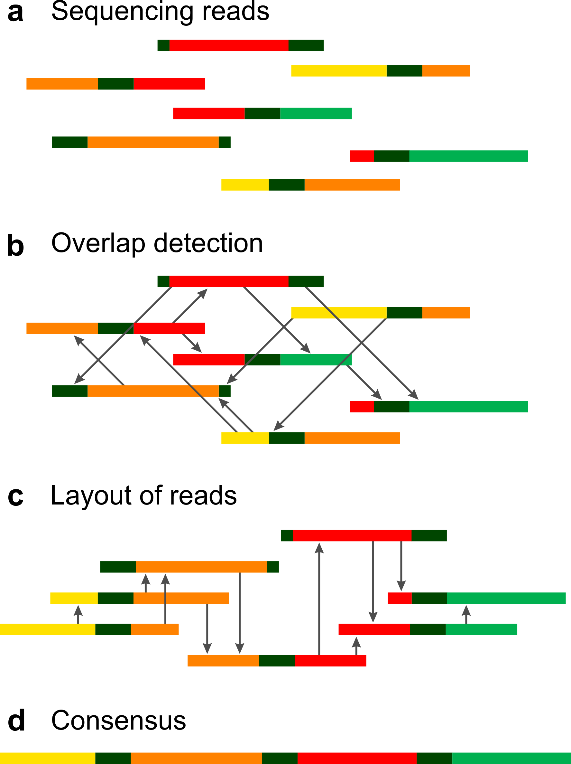
Overlap-layout-consensus
Straightforward search for all overlaps between all pairs of reads
Retains read information
Slow and computationally intensive
Better for longer reads
Source: Vollmers et al. 2017, PLoS One
Notes:
These are both graph-based algorithms, meaning we treat the reads as nodes in a graph, and their overlaps as edges in the graph.

Slide 54
de Bruijn graphs chop up the reads even further into segments of length k called k-mers
k-mers
Substrings of length k
Source: Pevzner et al. 2001, PNAS
Notes:
For short reads, the main method for assembly is to rely on the de Bruijn graph on smaller segments of the DNA. Wait, why would we want to cut up our already small reads into smaller segments, called k-mers? As stated here it looks “childish and irresponsible”. Well, we do this to take full advantage of the overlaps between reads. With smaller kmers, we can effectively walk a path between reads using their overlapping nature.

Slide 55
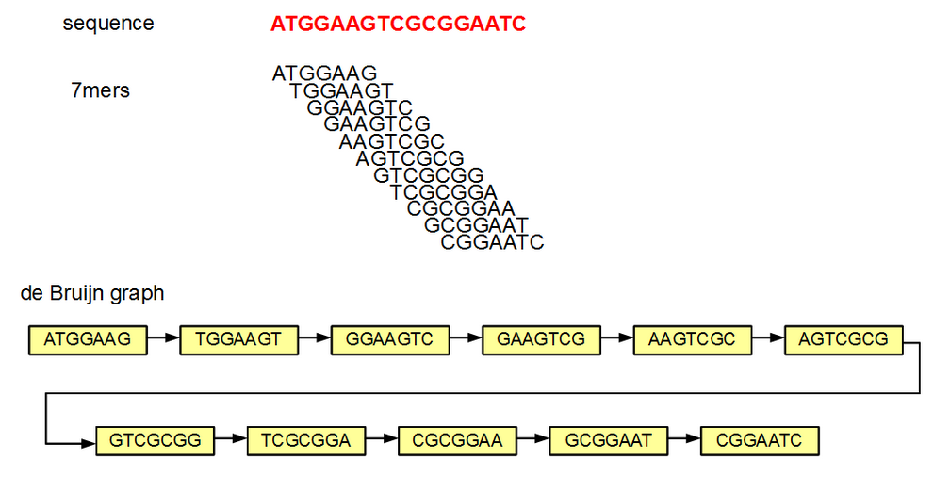
Overlaps of k-1 are used to construct the de Bruijn graph
Source: https://naturalis.github.io/mebioda/doc/week1/w1d2/lecture1.html

Slide 56
Overlaps of k-1 are used to construct the de Bruijn graph
k-mer selection depends on read length
Smaller k means more repeats joined and shorter contigs
Higher k can lead to a fragmented graph
Source: https://naturalis.github.io/mebioda/doc/week1/w1d2/lecture1.html

Slide 57
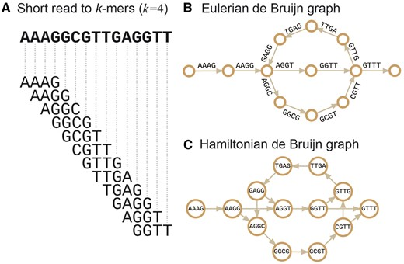
Two strategies to de Bruijn graph problems
Source: The present and future of de novo whole-genome assembly

Slide 58
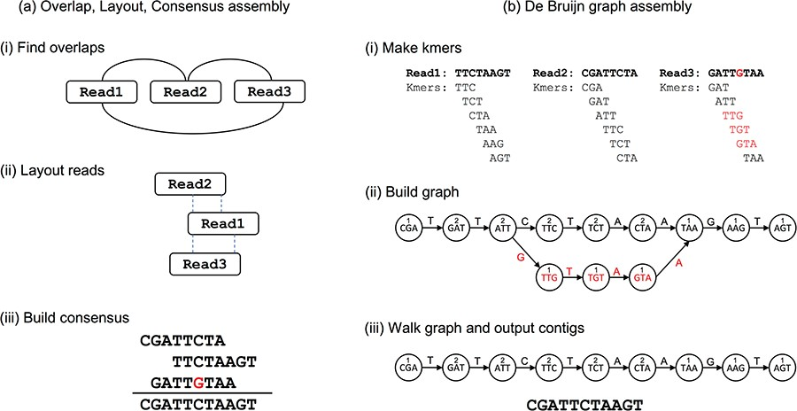
Two main classes of assembly algorithms
Overlap-Layout-Consensus
de Bruijn graph
(vertices are reads)

Slide 59
Two main classes of assembly algorithms
Overlap-Layout-Consensus
de Bruijn graph
(vertices are reads)
Time consuming for short reads
  One million reads -> one trillion pairwise alignments
Easier with new and highly accurate long reads
Memory requirements high
Much faster for short reads
Efficient algorithms to find paths through the graph
Reduces memory/time req’s (especially for Eulerian graphs)
Caveat: Modern assemblers often combine strategies, but practically it is important to know:
1. Computational requirements
2. Regions or genome qualities which may be “problematic” to assemble

Slide 60
How do we join contigs into longer scaffolds?
A contig (short for contiguous) is a sequence that has been generated by assembling reads
A scaffold is made up of adjacent contigs separated by gaps (stretches of Ns)
?

Slide 61
Scaffolding
Using read pairs that span contigs
Source: https://thesequencingcenter.com/knowledge-base/what-are-paired-end-reads/

Slide 62
Scaffolding
Using read pairs that span contigs
Source: https://thesequencingcenter.com/knowledge-base/what-are-paired-end-reads/

Slide 63
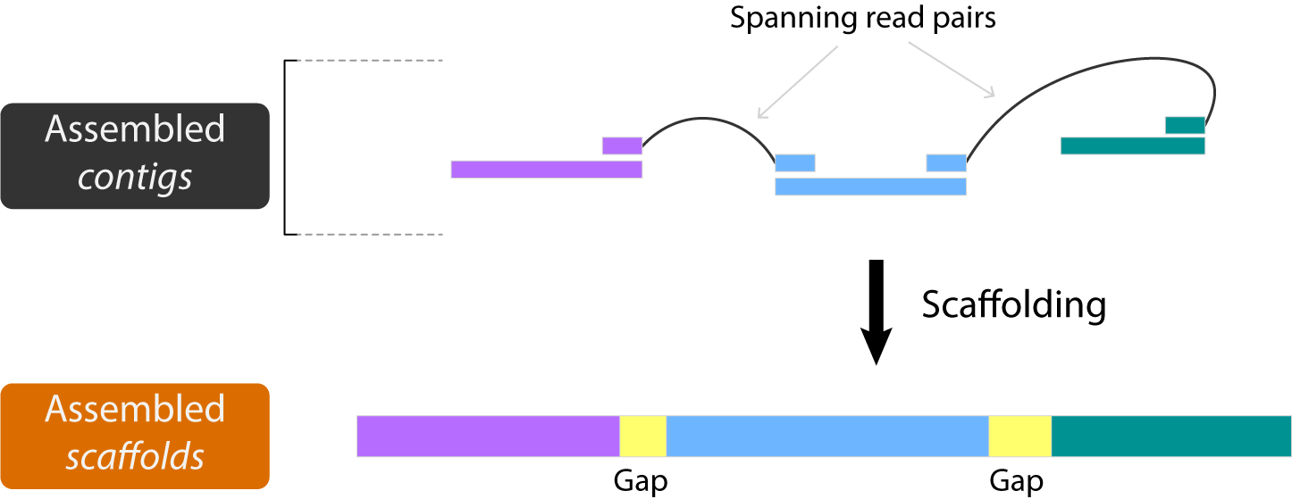
Scaffolding
Using read pairs that span contigs

Slide 64
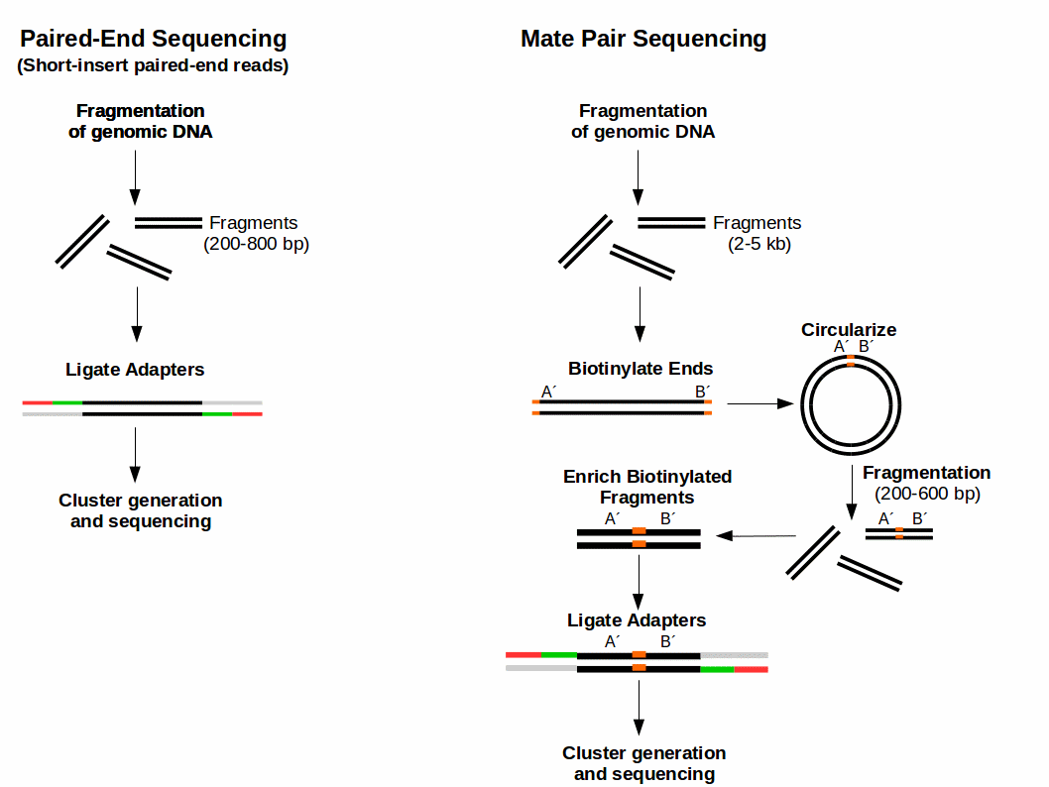
Scaffolding
Using read pairs that span contigs
Using long insert-size mate-pair libraries (“jumping libraries”)
Source: https://www.ecseq.com/support/ngs/what-is-mate-pair-sequencing-useful-for

Slide 65
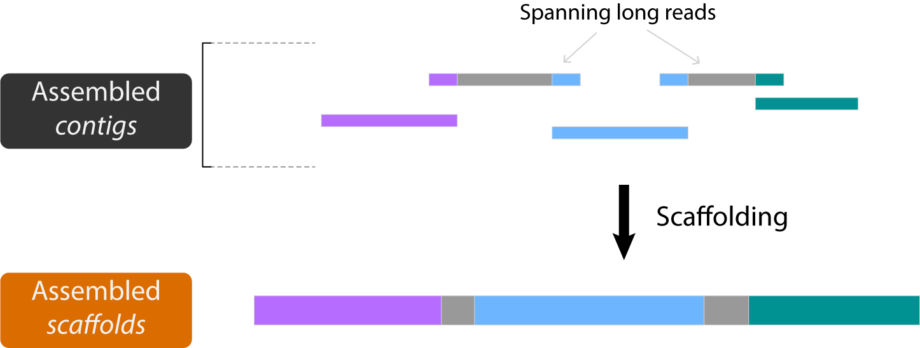
Scaffolding
Using read pairs that span contigs
Using long insert-size mate-pair libraries (“jumping libraries”)
Using long reads

Slide 66
Scaffolding
Using read pairs that span contigs
Using long insert-size mate-pair libraries (“jumping libraries”)
Using long reads
Hi-C chromosome conformation capture
Crosslink DNA that is close together in physical space when packed into chromatin with the assumption that DNA on the same chromosome will often be packed closely together
Source: Liebereman-Aiden et al. 2009, Science
Notes:
“The contact frequency between a pair of loci strongly correlates with the one-dimensional distance between them.”

Slide 67
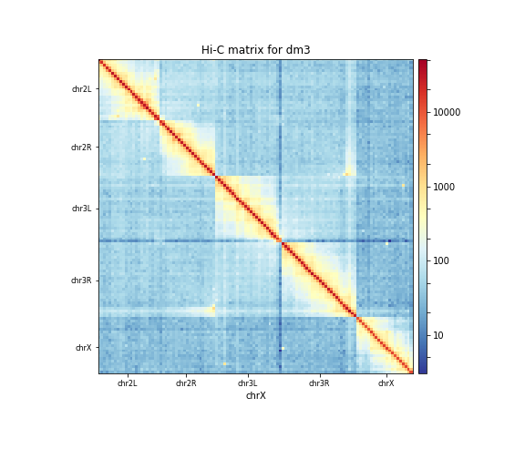
Scaffolding
Using read pairs that span contigs
Using long insert-size mate-pair libraries (“jumping libraries”)
Using long reads
Hi-C chromosome conformation capture
Source: https://training.galaxyproject.org/training-material/topics/epigenetics/tutorials/hicexplorer/tutorial.html

Slide 68
Scaffolding
Linked reads also group reads by chromosome
10x Genomics approaches this during the library phase using “linked read” strategy
Each GEM bead allows you to first assemble by DNA molecule
This then makes it computationally easier to overlay long haplotypes and place them
Source: 10X Genomics

Slide 69
Assemblies are haploid representations of genomes

Slide 70
Genome Phasing
What is phasing?
Phasing an assembly means to separate the maternal and paternal chromosomes. This has been relatively difficult until recently when long read sequencing could more easily resolve haplotypes.
Source: 10X Genomics

Slide 71
Genome Phasing
What is phasing?
Phasing an assembly means to separate the maternal and paternal chromosomes. This has been relatively difficult until recently when long read sequencing could more easily resolve haplotypes.
Source: 10X Genomics

Slide 72
Genome Phasing
What is phasing?
Phasing an assembly means to separate the maternal and paternal chromosomes. This has been relatively difficult until recently when long read sequencing could more easily resolve haplotypes.
Source: 10X Genomics

Slide 73
Genome Phasing
How can we accomplish phasing?
Pacbio, Nanopore, and linked read techs addresses this by using long reads and identifying alternative haplotigs
Create an assembly graph that contains “bubbles” which represent structural variation and alternative haplotypes (with different SNPs)
Break these apart by identifying which reads go with each haplotype
Source: Chin et al. 2016, Nat Methods

Slide 74
Genome Phasing
How can we accomplish phasing?
Trio binning describes the process of using the maternal and paternal haplotypes to resolve offspring assembly
Assign reads from child to each paternal haplotype

Slide 75
How do we capture population level variation in genome assemblies?
Genome assemblies are from single individuals
Loops in graph represent repeat regions
Pan-genomes are assemblies from multiple individuals
Loops in graph represent population level variation
Source: Eizenga et al. 2020, Annual Review of Genomics and Human Genetics

Slide 76
How do we capture population level variation in genome assemblies?
Genome assemblies are from single individuals
Loops in graph represent repeat regions
Pan-genomes are assemblies from multiple individuals
Loops in graph represent population level variation
Source: Eizenga et al. 2020, Annual Review of Genomics and Human Genetics

Slide 77
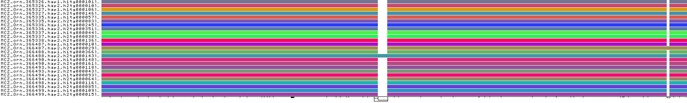
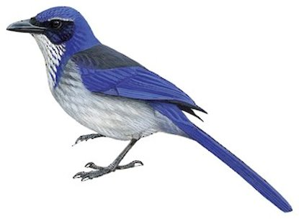

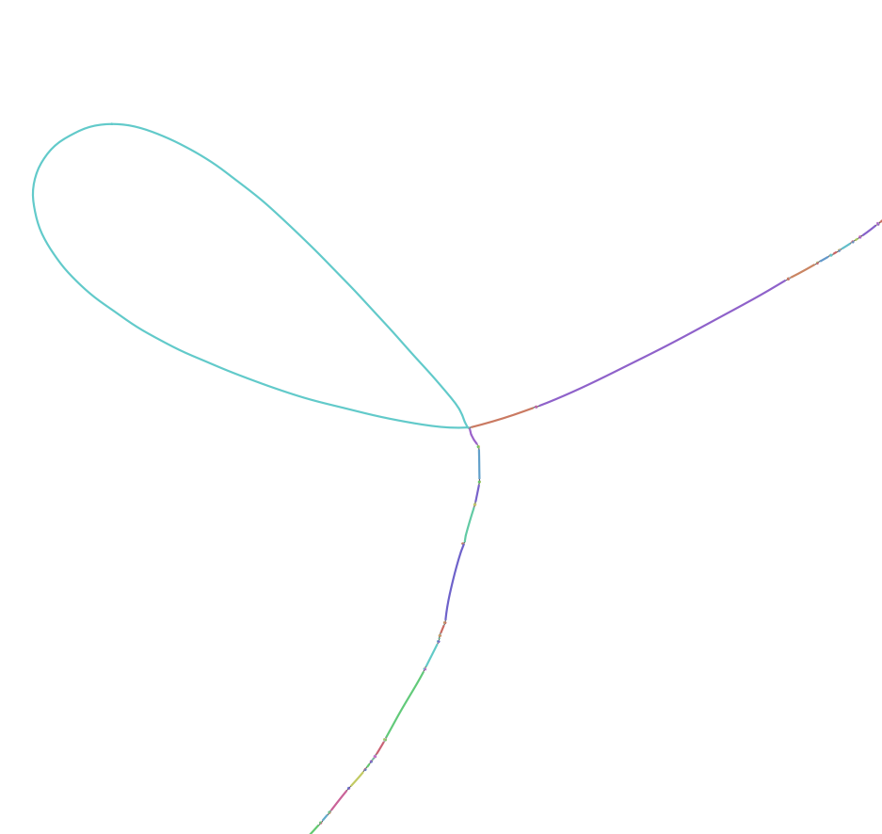
Genomic stability of 400-kb hox1a region in Western Scrub Jays
Pangenome graphs
generated with odgi
and visualized with Bandage
Slide from Scott Edwards
Guarracino et al. 2021. Bioinformatics, in press.
Wick et al. 2015. Bioinformatics 31:3350.
7.5 kb polymorphic indel
2.5 kb polymorphic indel

Slide 78
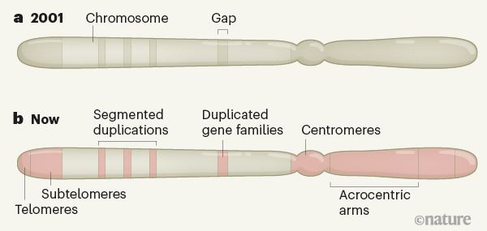
Telomere-to-telomere assemblies
Initial genome assemblies are full of gaps (repeat regions)
Improved scaffolding and long reads allow these gaps to be resolved
Allows for study of whole genome, but requires much more sequencing
Source: Miga 2021, Nature

Slide 79

How can we evaluate the quality of an assembly?
Assembly statistics (N & L stats), length, GC content, etc. (Assemblathon, BUSCO)
Error calculations (Merqury, Referee)
Contamination screening (NCBI, blobtools)
Branch Universal Single Copy Orthologs (BUSCO) or compleasm
Also: Number of repeats, number of annotated genes, etc. can give you hints to possible sources of error in your assembly

Slide 80
1. | A brief history of sequencing technology
2. | de novo Assembly: reads, contigs, and scaffolds
3. | Practical considerations for genome assembly

Slide 81
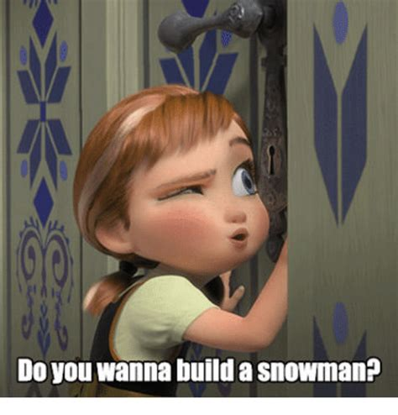
So you want to build a genome?
Some factors to consider:
-Organism ploidy
-Genome size (http://www.genomesize.com, https://cvalues.science.kew.org/)
-Repeat content
-How much/what quality of DNA will you have available?
-What are you using it for?
genome

Slide 82
So you want to build a genome?
How is this relevant to assembly?
-when there are many copies of chromosomes, the assemblers can have a difficult time telling what goes where
-genome size tends to be large, and can contain many complex repeat regions from the duplications
-phasing also more complex/difficult
-common in plants, but also seen in amphibians, reptiles, arthropods
Ploidy: the number of sets of chromosomes in a cell

Slide 83
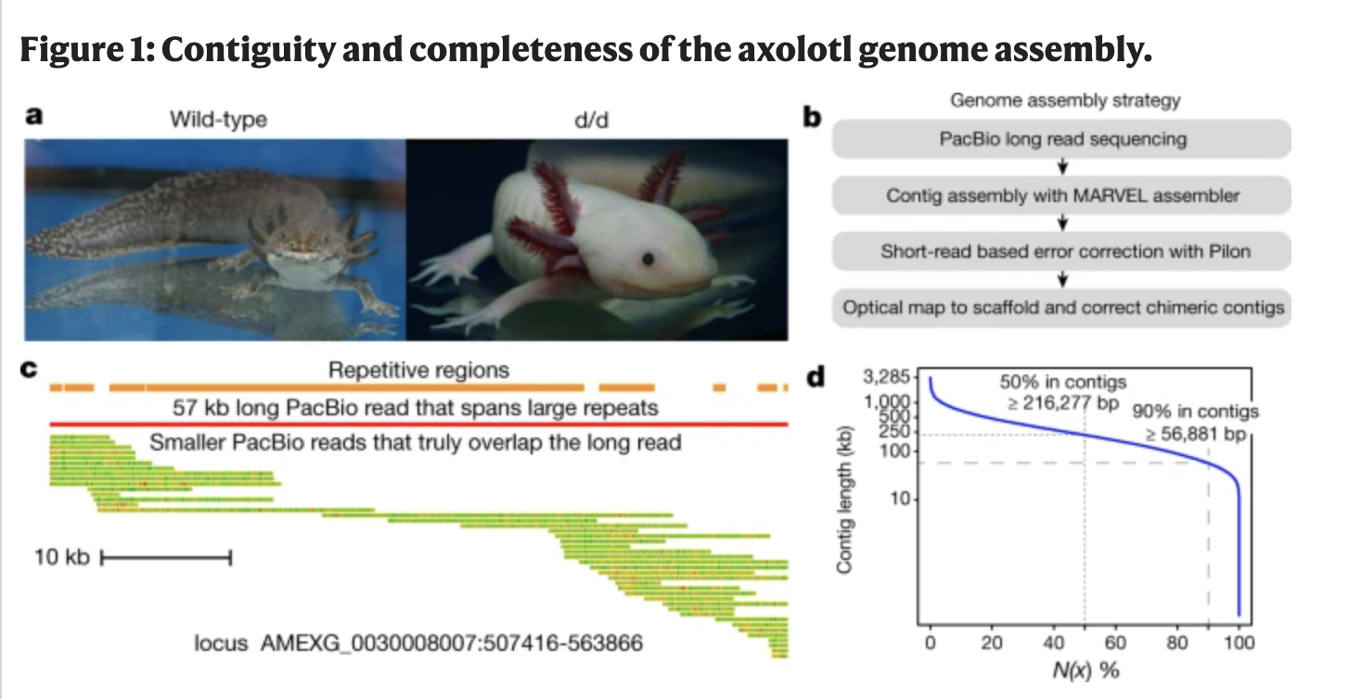
So you want to build a genome?
-In general, repeat content scales with genome size
-Repeats (depending on their class) can be hard to assemble and resolve
-If you have a lot of repetitive content, longer reads will be better at resolving this
Repeat Content!
Probably not junk, but we don’t really know
Elliot and Gregory 2015
Nowoshilow et al. 2018

Slide 84
So you want to build a genome?
C value: Estimate of genome size based on flow cytometry
-Some groups of organisms have conserved genome sizes (birds, mammals)
-Others have high variability (arthropods, frogs, plants)
-Can be difficult to predict assembly size (which affects how much and what you would sequence) in some groups, so tread carefully

Slide 85
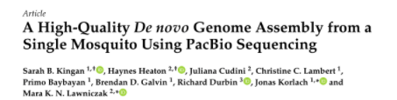
So, you want to build a genome?
Genome Assembly options depend both on the quality and quantity of DNA available
-Certain techs require a lot of high molecular weight DNA (long, intact molecules), while other methods fix the DNA while it’s folded
-Depending on the size/clonality/heterozygosity of your organism, pooling may be necessary, but could complicate things
-Things could also get, well, slime-y
Some organisms are harder to get
higher DNA yields than others due
to inhibitors etc.
-Protocols are getting better at making whole genome libraries with low yields

Slide 86
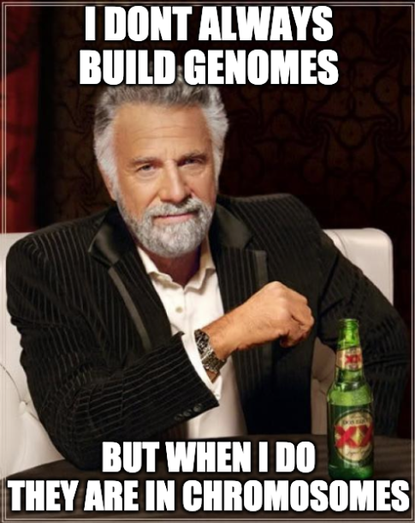
So you want to build a genome?
-Chromosome level assemblies are ideal, but they may not be necessary to answer YOUR question
-Consider what level of information you would need to answer questions about:
  Population structure
  Genomic history
  Structural variation
  Adaptation
  Functional variation
  ???

Slide 87




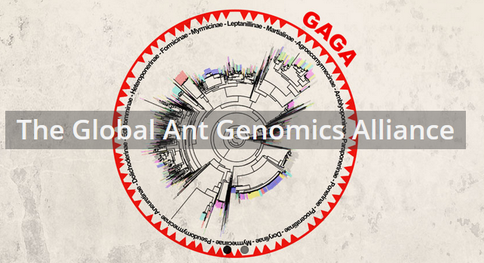
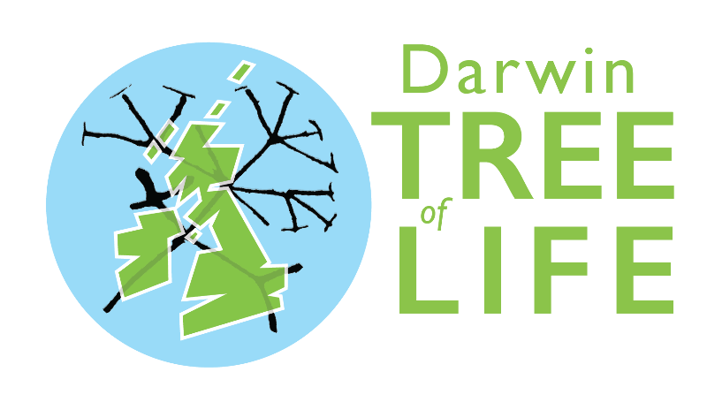



Slide 88
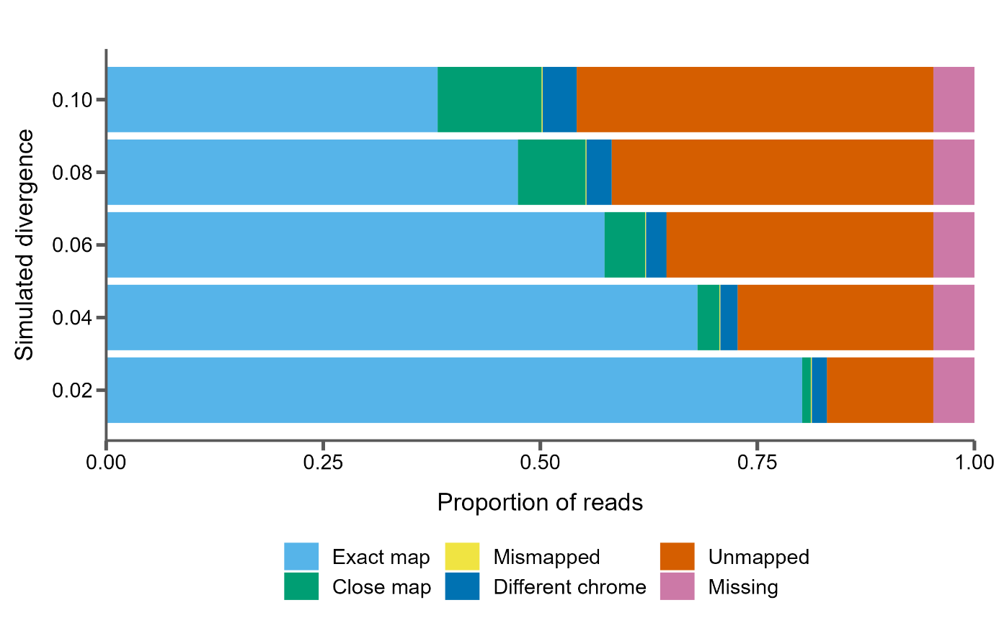
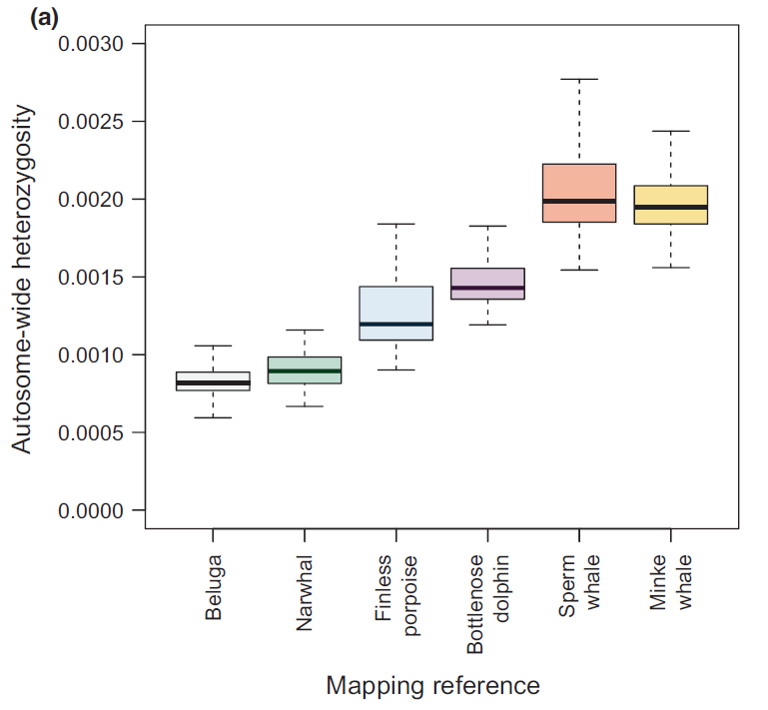
Don’t build a house on a bad foundation
Source: Thomas et al. in prep
Reference bias is a very real problem and is difficult to quantify
It can affect:
Species tree inference
Heterozygosity estimation
ROH estimation
Load calculations
Source: Prasad et al. 2021, MER

Slide 89
https://gwct.github.io/congen/assembly/

